Slide 1
Python Directory Management
DVT101 – Lecture 50
- By Dataverse Tutorials

Slide 2
Introduction to Python Directory Management
Meaning of directory management
Why directories matter in real applications
Difference between files and directories
Python as a cross-platform solution

Slide 3
Why Directory Management is Needed
Organizing files programmatically
Automation of repetitive folder tasks
Handling dynamic project structures
Importance in real-world workflows

Slide 4
Modules Used for Directory Management
Role of os module
Role of os.path submodule
Role of pathlib module
Role of shutil module

Slide 5
Understanding Directory vs File
What is a directory
How OS stores directories internally
Difference in operations for files and folders
Common beginner confusion

Slide 6
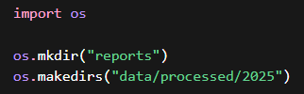
Creating Directories Concept
Need for dynamic directory creation
Single-level directory creation idea
Nested directory creation idea
Error scenarios during creation

Slide 7
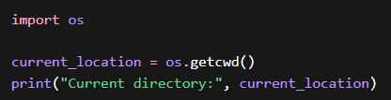
Current Working Directory (CWD) Concept
Meaning of current working directory
Script location vs working directory
Importance of CWD in relative paths
Common mistakes beginners make

Slide 8

Renaming and Moving Directories
Why renaming directories is required
Renaming vs moving concept
Handling missing intermediate paths
Real project use cases

Slide 9
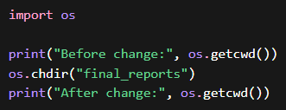
Changing the Working Directory
Why changing directory context is useful
Impact on file and folder operations
Temporary vs permanent context change
Automation and batch processing use

Slide 10
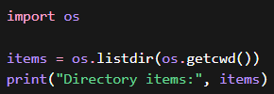
Listing Directory Contents
Why directory listing is required
Non-recursive listing concept
Recursive listing intuition
Use in cleanup and monitoring scripts

Slide 11
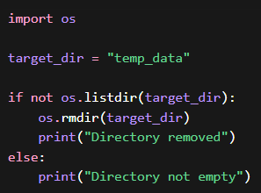
Removing Directories Safely
Difference between empty and non-empty directories
Safe deletion principles
Risks of accidental deletion
When recursive deletion is needed

Slide 12
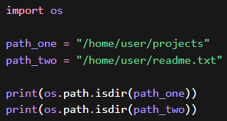
Directory Validation
Checking if path is a directory
Avoiding wrong operations
Validation-first mindset
Reliability in scripts

Slide 13
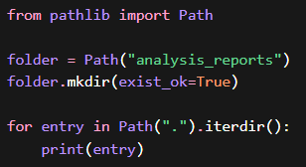
Directory Management with pathlib
Object-oriented directory handling
Cleaner alternative to os module
Path-based directory creation
Readability and safety benefits

Slide 14
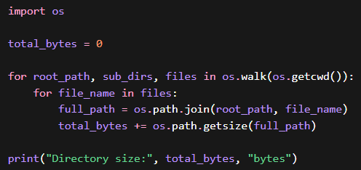
Directory Size Calculation Concept
Why directory size matters
Recursive size calculation idea
File size vs directory size
Monitoring and analytics use cases

Slide 15
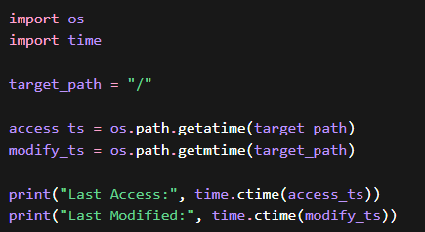
Access and Modification Time Concept
Meaning of access time
Meaning of modification time
Why timestamps are important
Backup and audit use cases

Slide 16
shutil Module Overview
Why shutil exists
High-level directory operations
Difference from os module
Safety and power trade-offs

Slide 17
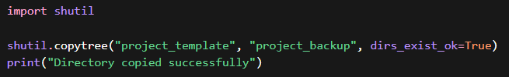
Copying Directories Concept
Recursive copy idea
Source vs destination roles
Handling existing directories
Real-world backup scenarios

Slide 18
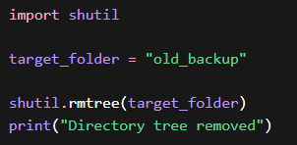
Removing Directory Trees
Recursive deletion concept
Why it is dangerous
Use cases in cleanup pipelines
Best practices before deletion

Slide 19
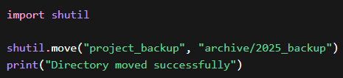
Moving Directories Concept
Move vs rename distinction
Same filesystem vs different filesystem
Impact on data integrity
Deployment and reorganization use

Slide 20
Real-World Industry Use Cases
Data science project structuring
Backend log and media handling
DevOps automation scripts
ETL and batch pipelines

Slide 21
Summary & Key Takeaways
What directory management enables
Choosing the right module
Safety-first approach
Transition to hands-on coding

Slide 22


